Slide 1

Algebra 1
Unit 14, Lesson 4 Determining Possible Associations in Data Volume 2, pg. 321

Slide 2


Benchmark
MA.912.DP.3.1
Construct a two-way frequency table summarizing bivariate categorical data. Interpret joint and marginal frequencies and determine possible associations in terms of a real-world context.
volume 2, pg. 321

Slide 3
Integrated Mathematical Thinking and Reasoning Standards
MA.K12.MTR.2.1 Demonstrate understanding by representing problems in multiple ways.
MA.K12.MTR.4.1 Engage in discussions that reflect on the mathematical thinking of self and others.
MA.K12.MTR.6.1 Assess the reasonableness of solutions.
MA.K12.MTR.7.1 Apply mathematics to real-world contexts.
volume 2, pg. 321

Slide 4

Learning Target
I can determine possible associations from a two-way table and segmented bar graph.
volume 2, pg. 321

Slide 5

Warm-Up
volume 2, pg. 321

Slide 6
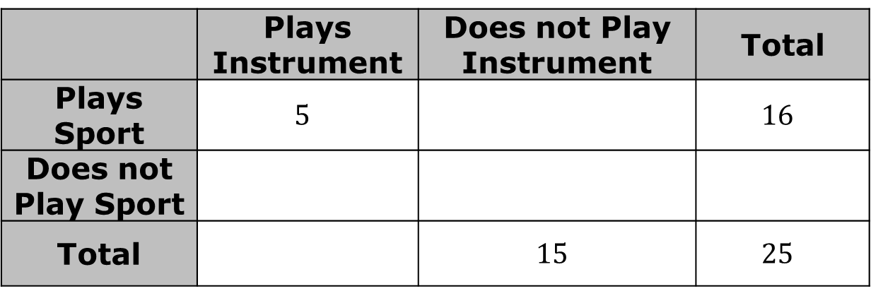
14.4.1 Warm-Up: Playing Instruments and Sports
Orlando asked his classmates these questions:
Do you play a sport?
Do you play a musical instrument?
The two-way table gives partial results from the survey. Complete the table, assuming that all students answered both questions.
 | Plays Instrument | Does not Play Instrument | Total
Plays Sport | $$5$$ |  | $$16$$
Does not Play Sport
Total |  | $$15$$ | $$25$$
volume 2, pg. 321

Slide 7
What fraction of the total students do not play an instrument and also do not play sports?
Does the fraction you found in represent a joint or marginal relative frequency?
volume 2, pg. 321

Slide 8

Guided Instruction
volume 2, pg. 322

Slide 9

14.4.2 Guided Instruction: Finding Possible Associations in the Data
Two-way tables are effective for organizing data. Creating a segmented bar graph for the data in a two-way table can help make possible associations more visible.
An association is a way to describe the relationship between the two variables in a bivariate data set. For categorical data, descriptions include strong or weak.
volume 2, pg. 322

Slide 10
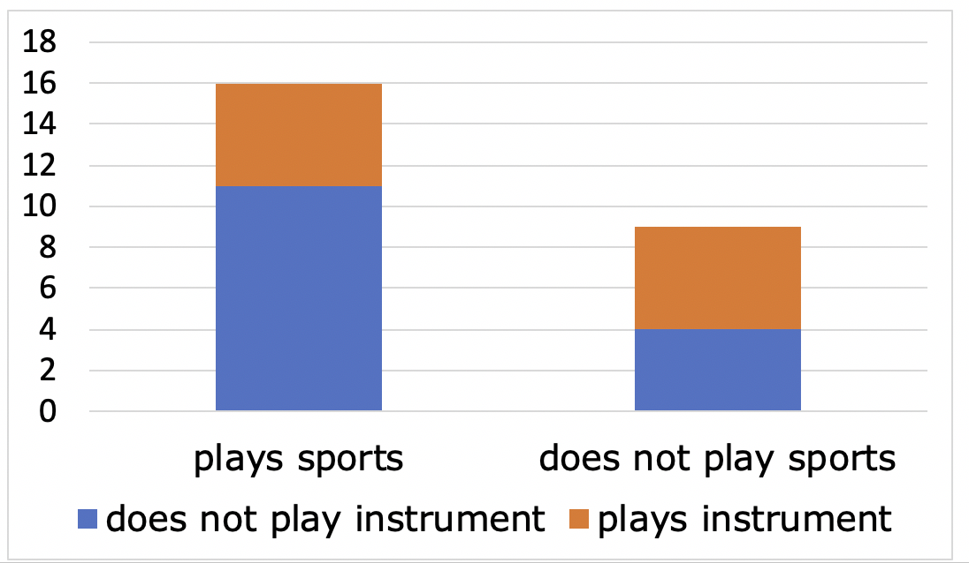
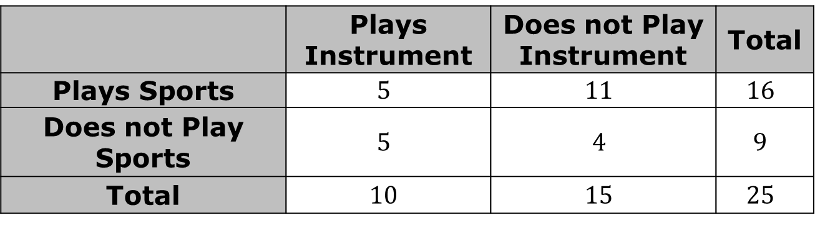
Orlando would like to know if there is any association between playing an instrument and playing a sport. He makes a segmented bar graph from the data in the two-way table.
 | Plays Instrument | Does not Play Instrument | Total
Plays Sports | $$5$$ | $$11$$ | $$16$$
Does not Play Sports | $$5$$ | $$4$$ | $$9$$
Total | $$10$$ | $$15$$ | $$25$$
volume 2, pg. 322

Slide 11
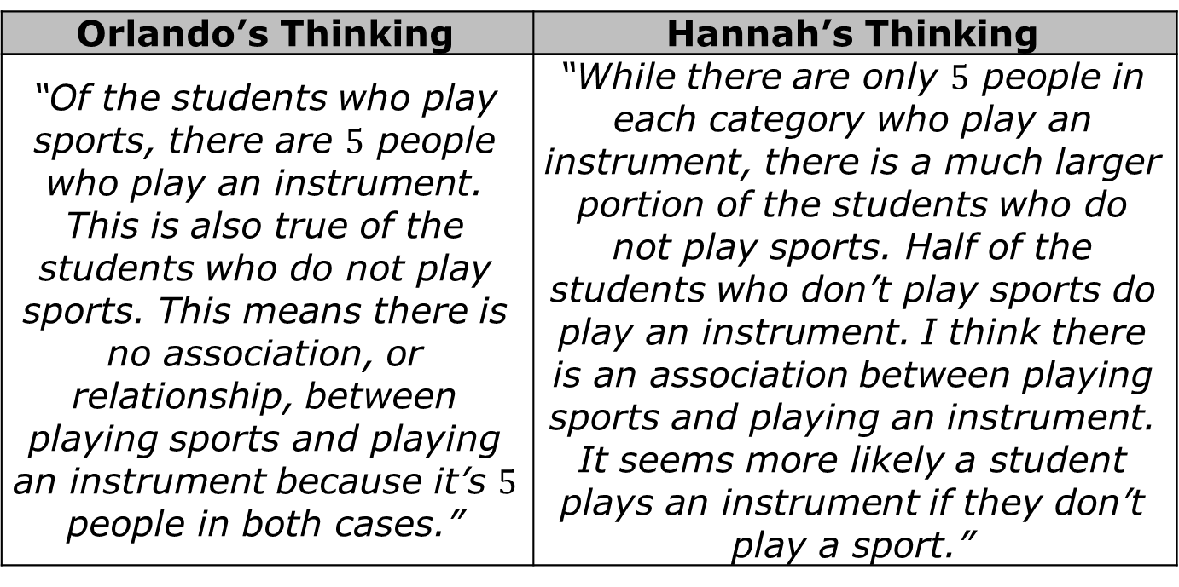
Orlando and Hannah discussed possible associations in the data using the displays. Each student’s thinking is shared in the table.
Orlando’s Thinking | Hannah’s Thinking
“Of the students who play sports, there are $5$ people who play an instrument. This is also true of the students who do not play sports. This means there is no association, or relationship, between playing sports and playing an instrument because it’s $5$ people in both cases.” | “While there are only $5$ people in each category who play an instrument, there is a much larger portion of the students who do not play sports. Half of the students who don’t play sports do play an instrument. I think there is an association between playing sports and playing an instrument. It seems more likely a student plays an instrument if they don’t play a sport.”
volume 2, pg. 322

Slide 12
Without the help of your partner, explain whether you agree more with Orlando or Hannah.
Compare your answer with your partner’s. Make any edits to your explanation based on your discussion.
volume 2, pg. 322

Slide 13

Bring It Together
volume 2, pg. 323

Slide 14

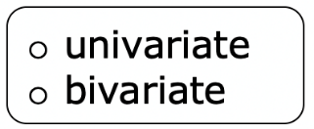
14.4.3 Bring It Together: Using Segmented Bar Graphs to Find Possible Associations
Complete the statements.
Segmented bar graphs are useful for displaying
Categorical data.
Segmented bar graphs can be helpful for making visual comparisons between joint and marginal frequencies. Take, for example, the bar on the left of the graph from the previous component labeled “plays sports.”
volume 2, pg. 323

Slide 15
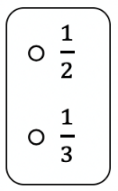
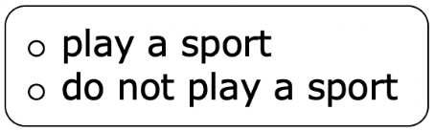
About of this bar is orange. The other bar, labeled “does
not play sports” is just over orange. This means a larger portion of the students who play an instrument, which means there may be an association between playing sports and instruments.
volume 2, pg. 323

Slide 16

Try It
volume 2, pg. 323

Slide 17

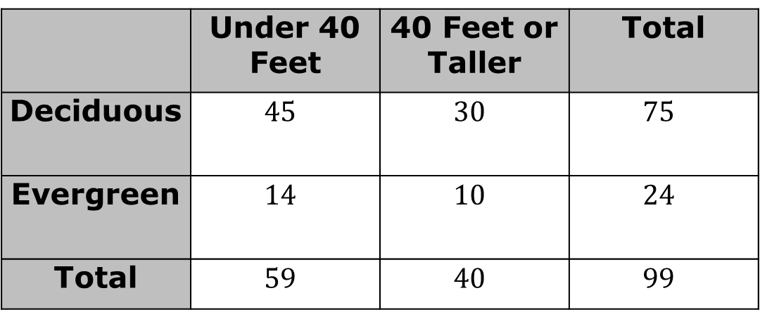
14.4.4 Try It: Possible Associations
An ecologist is studying a forest with a mixture of tree types. Since the average tree height in the area is 40 feet, the height of each tree is measured against that and recorded. The type of tree is also recorded. The results are shown in the table and segmented bar graphs.
 | Under 40 Feet | 40 Feet or Taller | Total
Deciduous | $$45$$ | $$30$$ | $$75$$
Evergreen | $$14$$ | $$10$$ | $$24$$
Total | $$59$$ | $$40$$ | $$99$$
volume 2, pg. 323

Slide 18
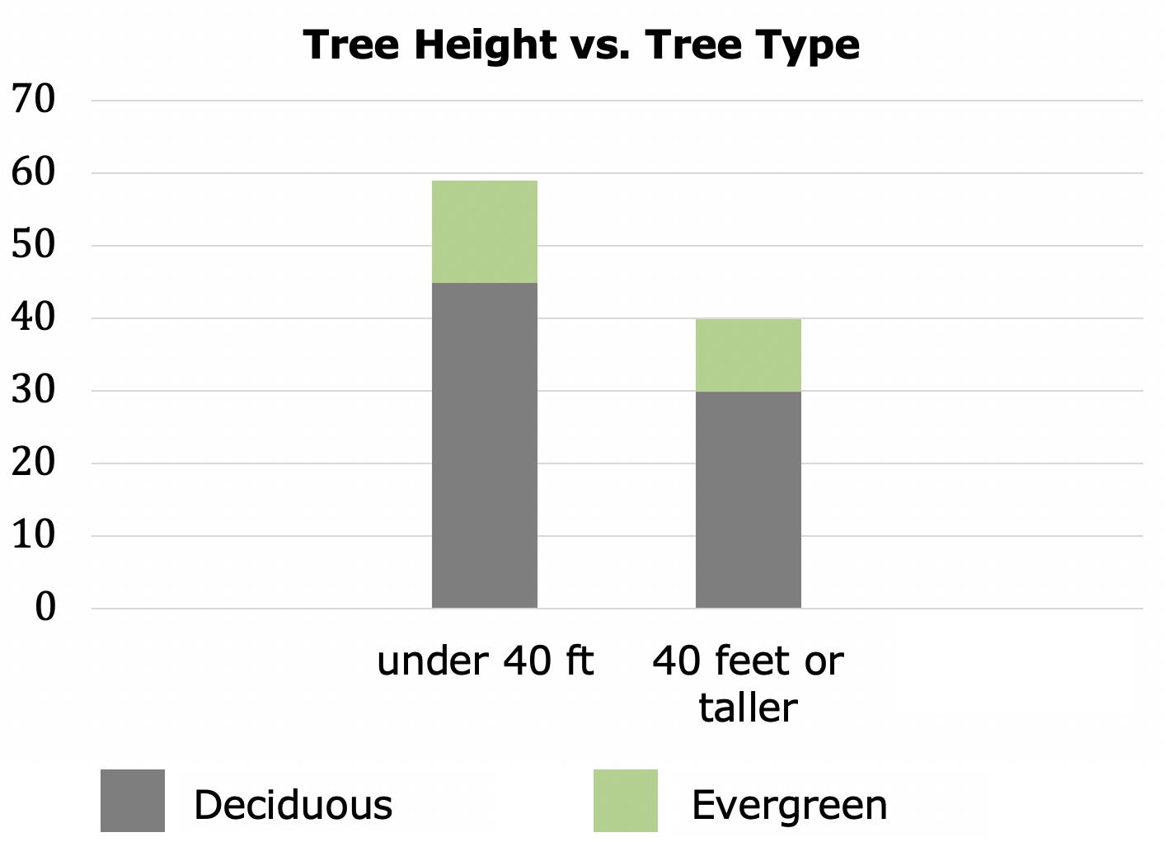
volume 2, pg. 323

Slide 19
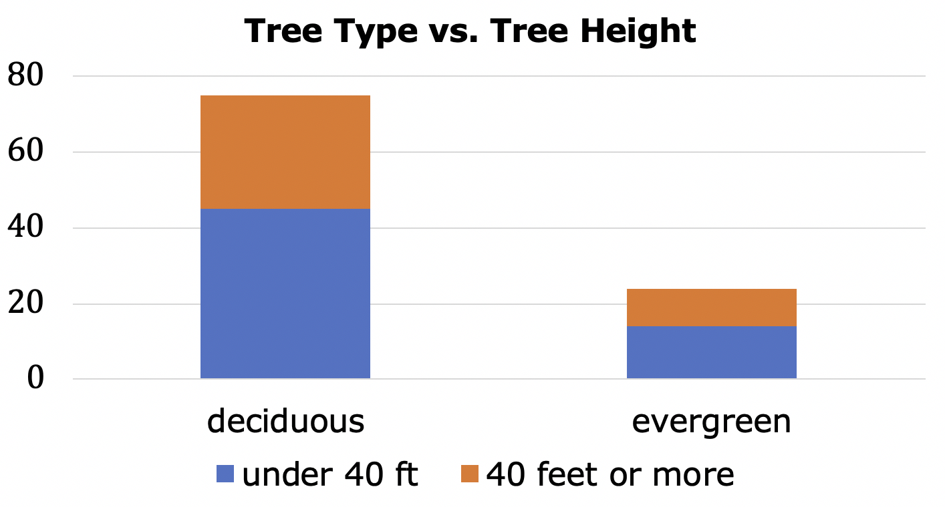
Explain whether or not there is evidence of an association between tree height and tree type.
Explain which data display was more helpful in determining whether or not there is evidence of an association between height and type of tree.
volume 2, pg. 324

Slide 20

Wrap-Up
volume 2, pg. 324

Slide 21
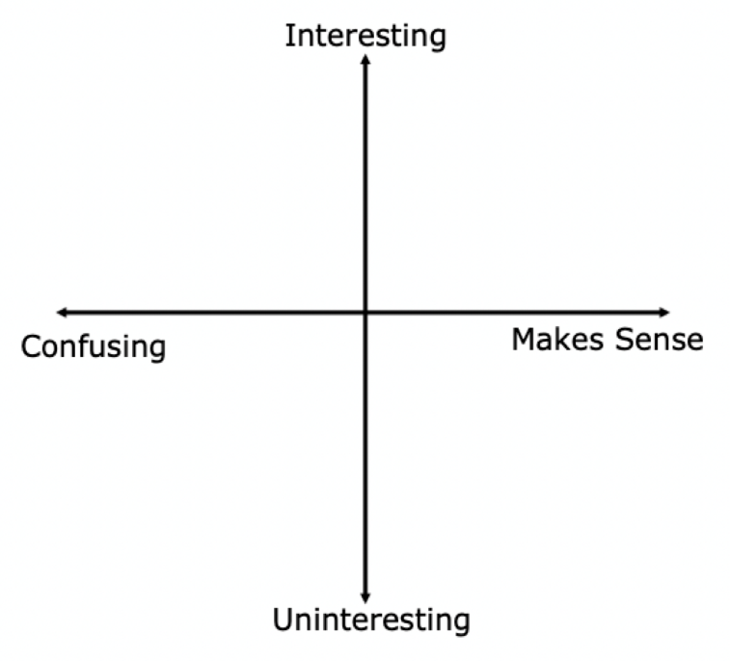
14.4.5 Wrap-Up: Reflection
Plot a point in one of the quadrants below to indicate where you are on today’s learning target, “I can determine possible associations from a two-way table and segmented bar graph.”
volume 2, pg. 324

